Slide 1

Raspberry pi GPIO Basic’s
Lecturer: Reza Arjmandi
Summer 2016
Preface:
This chapter contains some basic recipes for setting up and using the Raspberry Pi’s general-purpose input/output (GPIO) connector.

Slide 2
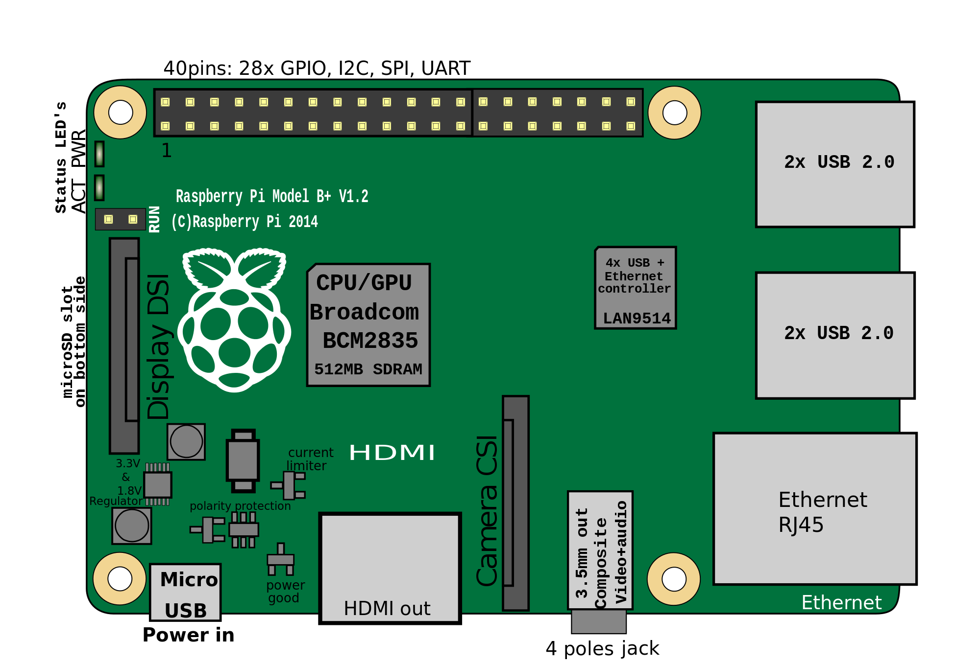
Raspberry pi Peripheral Circuits

Slide 3
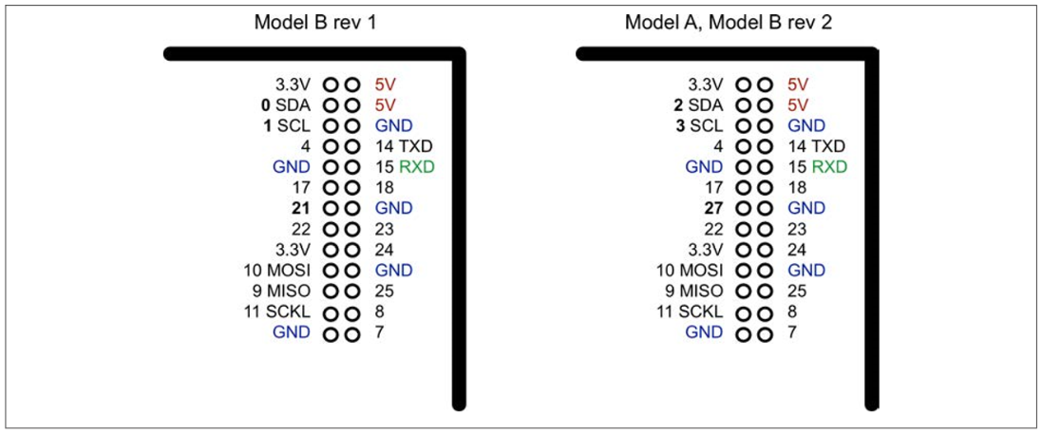
GPIO Schematic
There have actually been three versions of the Raspberry Pi GPIO connector. Two 26pin layouts for the original Raspberry Pi and one 40-pin layout that came in with the Raspberry Pi “+” models.
Following Figure shows the GPIO pinout for both revisions 1 and 2 of the Raspberry Pi Model B

Slide 4
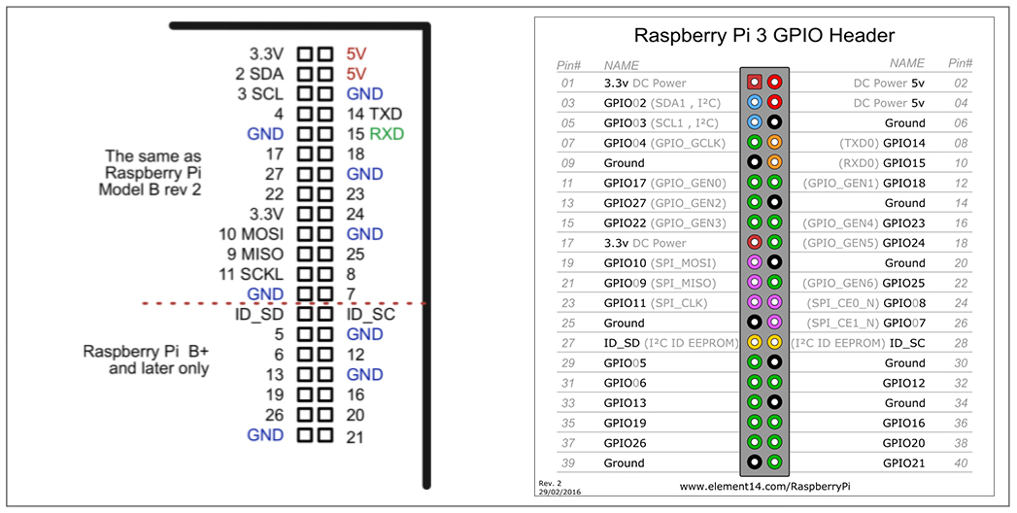
GPIO Schematic

Slide 5
GPIO Schematic
At the top of the connector, there are 3.3V and 5V power supplies. The GPIO uses 3.3V for all inputs and outputs. Any pin with a number next to it can act as a GPIO pin. Those that have another name after them also have some other special purpose, so 14 TXD and 15 RXD are the transmit and receive pins of the serial interface. SDA and SCL form the I2C interface, and MOSI, MISO, and SCKL from the SPI interface.
A GPIO pin can be used as either a digital input or a digital output, and both operate at 3.3V. Unlike the Arduino, the Raspberry Pi does not have any analog inputs. For that you must use an external analog-to-digital converter (ADC) or connect the Pi to an interface board (like the Gertboard) or to an Arduino or an aLaMode board, as discussed in future

Slide 6
Keeping Your Raspberry Pi Safe when Using the GPIO Connector
Obey these simple rules to reduce the risk of damaging your Raspberry Pi when using the GPIO connector:
Do not put more than 3.3V on any GPIO pin.
Do not draw more than 3mA per output. You can get away with drawing more, but this may shorten the life of the Pi. 3mA is enough to light a red LED with a 470Ω series resistor.
Do not poke at the GPIO connector with a screwdriver or any metal object when the Pi is powered up.
Do not power the Pi with more than 5V.
Do not draw more than a total of 50mA from the 3.3V supply pins.
Do not draw more than a total of 250mA from the 5V supply pins.

Slide 7
RPI.GPIO Library
For use GPIO pins you should add RPi.GPIO in your code:
import RPi.GPIO
For using functions:
RPi.GPIO.setup(18,RPi.GPIO.OUT)
OR
import RPi.GPIO as GPIO
For using functions:
GPIO.setup(18,GPIO.OUT)

Slide 8
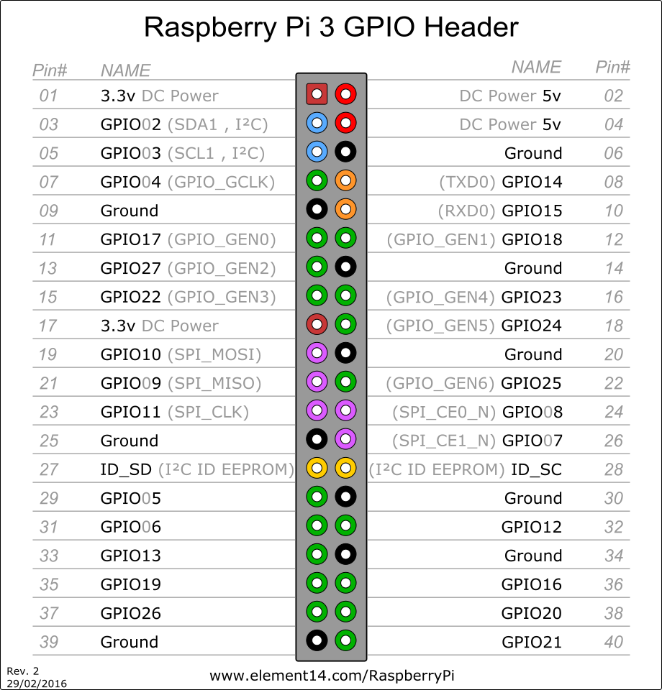
Setting up numbering system for RPi.GPIO
In RPi.GPIO you can use either pin numbers (BOARD) or the Broadcom GPIO numbers (BCM), but you can only use one system in each program.
Use setmode() function:
# for GPIO numbering, choose BCM
GPIO.setmode(GPIO.BCM)
# or, for pin numbering, choose BOARD
GPIO.setmode(GPIO.BOARD)

Slide 9
Setting up direction for RPi.GPIO
A GPIO pin can be used as either a digital input or a digital output
Use setup() function:
# for Output:
GPIO.setup(18, GPIO.OUT)
# for Input:
GPIO.setup(18, GPIO.IN)

Slide 10
Setting up direction for RPi.GPIO
#enable pull up resistor:
GPIO.setup(18, GPIO.IN, pull_up_down=GPIO.PUD_UP)
#enable pull down resistor:
GPIO.setup(18, GPIO.IN, pull_up_down=GPIO.PUD_DOWN)
Each GPIO pin has software configurable pull-up and pull-down resistors. When using a GPIO pin as an input, you can configure these resistors so that one or either or neither of the resistors is enabled, using the optional pull_up_down parameter to GPIO.setup. If this parameter is omitted, then neither resistor will be enabled. This leaves the input floating, which means that its value cannot be relied upon and it will drift between high and low depending on what it picks up in the way of electrical noise.

Slide 11
Produce Output
If a pin configure as output use output function:
# for Output:
GPIO.setup(18, GPIO.OUT) #or GPIO.setup(18, GPIO.OUT,initial=1)
#Then, to switch the port/pin to 3.3V (equals 1/GPIO.HIGH/True)…
GPIO.output(18, 1)
#Or, to switch the port/pin to 0V (equals 0/GPIO.LOW/False)…
GPIO.output(18, 0)

Slide 12
Reading Input
If a pin configure as input use input function:
# for Input:
GPIO.setup(18, GPIO.IN, pull_up_down=GPIO.PUD_UP)
#Then, for reading input:
if(GPIO.input(18)==0):
print(“key is pressed”)

Slide 13
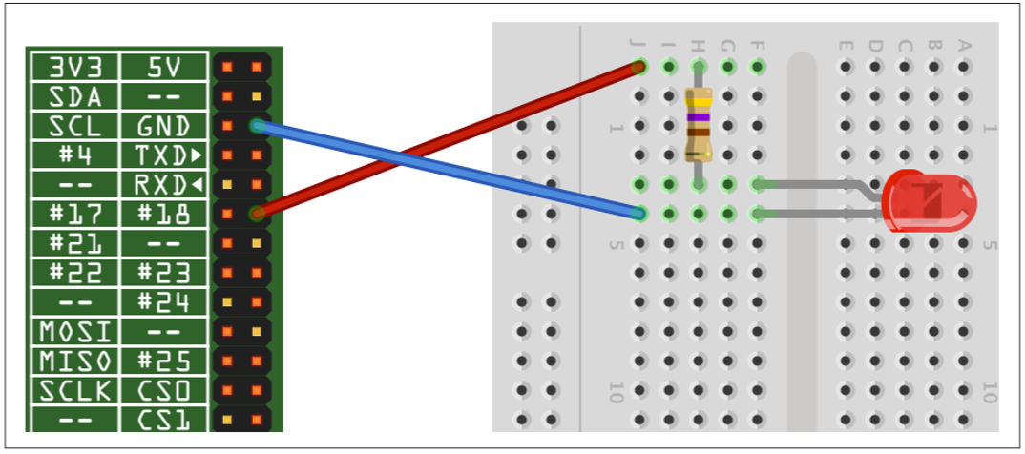
Connecting an LED
Connect an LED to one of the GPIO pins using a 470Ω or 1kΩ series resistor to limit the current.

Slide 14
Connecting an LED
Start a Python console from the Terminal with superuser access and enter these commands:
import RPi.GPIO as GPIO
import time
GPIO.setmode(GPIO.BCM)
GPIO.setup(18, GPIO.OUT)
while (True):
GPIO.output(18, True)
print(“ON”)
time.sleep(0.5)
GPIO.output(18, False)
print(“OFF”)
time.sleep(0.5)

Slide 15
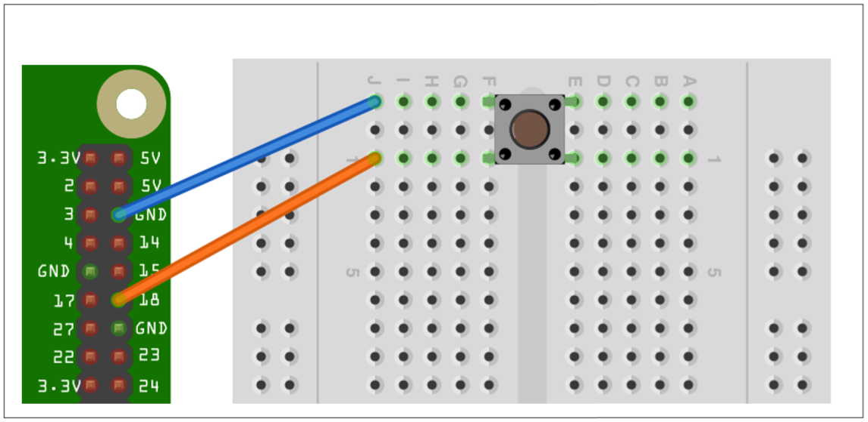
Connecting a Push Switch

Slide 16
Connecting a Push Switch
import RPi.GPIO as GPIO
import time
GPIO.setmode(GPIO.BCM)
GPIO.setup(18, GPIO.IN, pull_up_down=GPIO.PUD_UP)
while True:
if GPIO.input(18) == False:
print('Button Pressed')
time.sleep(0.2)

Slide 17
Connecting a Push Switch
You will need to run the program as superuser:
pi@raspberrypi ~ $ sudo python switch.py
You will notice that the switch is wired so that when it is pressed, it will connect pin 18 configured as an input to GND. The input pin is normally pulled up to 3.3V by the optional argument pull_up_down=GPIO.PUD_UP in GPIO.setup. This means that when you read the input value using GPIO.input, False will be returned if the button is pressed.

Slide 18
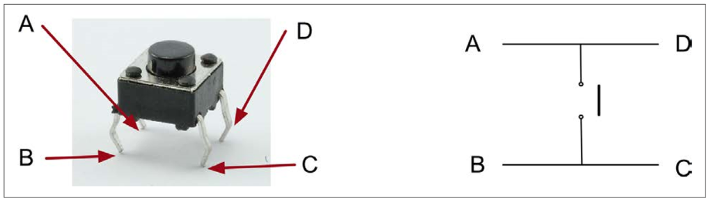
Connecting a Push Switch
You might expect the push switch to have just two connections, which are either open or closed. While some of these tactile push switches do have just two connections, most have four. Following Figure shows how these connections are arranged. Actually, there are only really two electrical connections, because inside the switch package pins B and C are connected together, as are A and D.

Slide 19
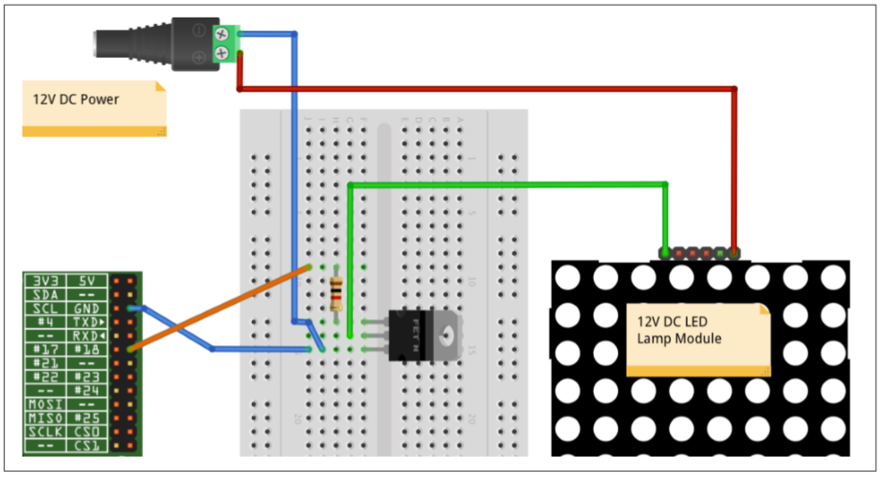
Switching a High-Power DC Device Using a Transistor
These high-power LEDs use far too much current to light directly from a GPIO pin. They also require 12V rather than the 3.3V. To control such a high-power load, you need to use a transistor.

Slide 20
Switching a High-Power DC Device Using a Transistor
the positive supply is connected directly to the positive side of the LED panel, and the negative side of the LED panel is connected to the drain of the MOSFET. The source connection of the MOSFET is connected to GND, and the MOSFET’s gate pin controls the flow of current from the drain to the source. If gate voltage is above about 2V, the MOSFET will turn on and current flows through both it and the LED module.

Slide 21
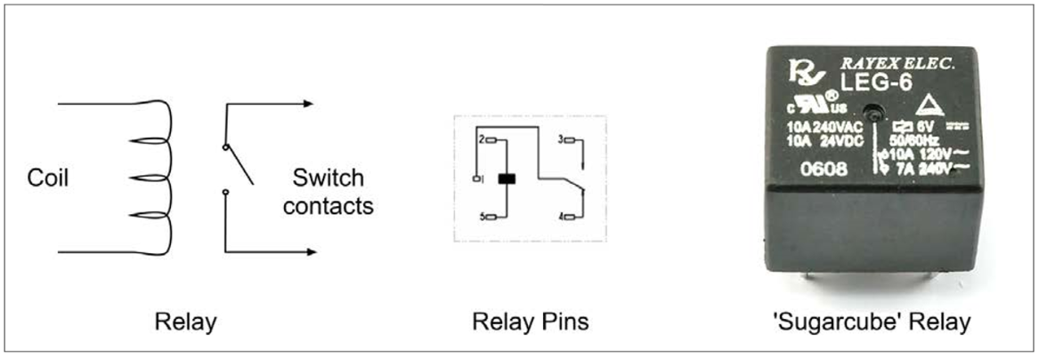
Switching a High-Power Device Using a Relay
Use a relay and small transistor.
relays are slow mechanical devices, so don’t try to use them with PWM. It may damage the relay.
Relays have been around since the early days of electronics and have the great advantage of being easy to use, plus they’ll work in any situation where a switch would normally work—for example, when you’re switching AC (alternating current) or in situations where the exact wiring of the device being switched is unknown.

Slide 22
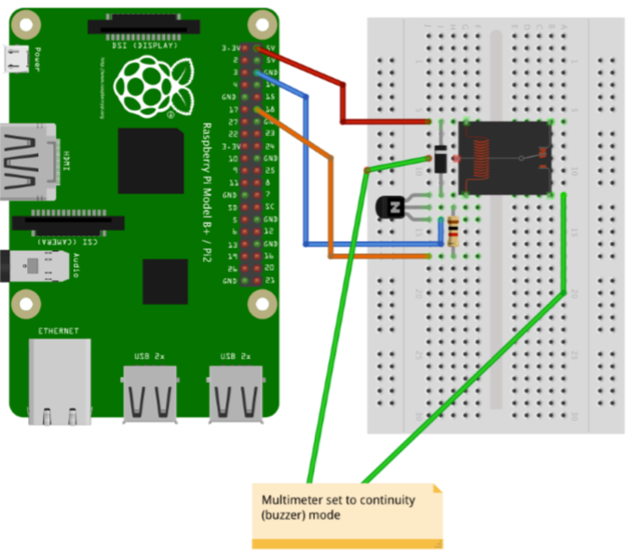
Switching a High-Power Device Using a Relay

Slide 23
Switching a High-Power Device Using a Relay
A relay is essentially a switch whose contacts are closed when an electromagnet pulls them together. Since the electromagnet and switch are not connected electrically in any way, this protects the circuit driving the relay coil from any high voltages on the switch side.
The downside of relays is that they are slow to operate and will eventually wear out after many hundreds of thousands of operations. This means they are only suitable for slow on/off control, not for fast switching like PWM.
The coil of a relay requires about 50 mA to close the connections. Because a Raspberry Pi GPIO pin is only capable of supplying about 3 mA, you need to use a small transistor as a switch
The base (middle lead) is connected to the GPIO pin via a 1kΩ resistor to limit the current. The emitter is connected to GND, and the collector to one side of the relay. The other side of the relay is connected to 5V on the GPIO connector.
The diode is used to suppress any highvoltage pulses that occur when the transistor rapidly switches the power to the relay’s coil.

Slide 24
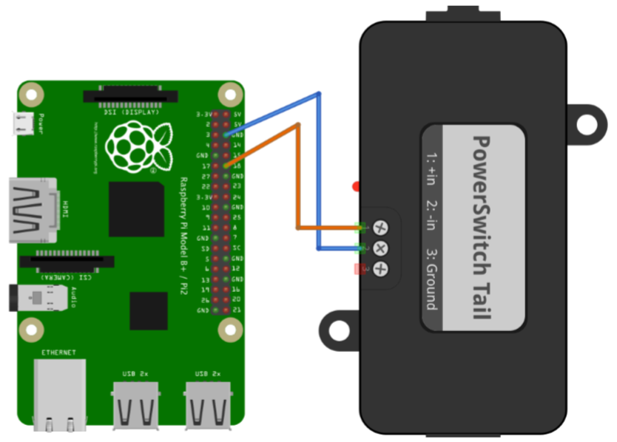
Controlling High-Voltage AC Devices
Use a PowerSwitch Tail II
The PowerSwitch Tail uses a relay, but to switch the relay, it uses a component called an opto-isolator that has an LED shining onto a photo-TRIAC (a high-voltage, lightsensitive switch); when the LED is illuminated, the photo-TRIAC conducts, supplying current to the relay coil.

Slide 25
The Raspberry GPIO in Depth
One of the challenges related to the Pi’s GPIO interface is that it uses a weak CMOS 3 V interface
The GPIO pins are susceptible to static electricity damage, and the I/O pins are weak drivers (2 to 16 mA)
Additionally, GPIO power must be budgeted from the total spare current capacity of 50 mA
Following figure show the schematic GPIO connections for the Raspberry Pi. You will notice that the GPIO pins are also designated with the GENx designation. (Gen 7 to 10 was not available prior to version 2.)

Slide 26
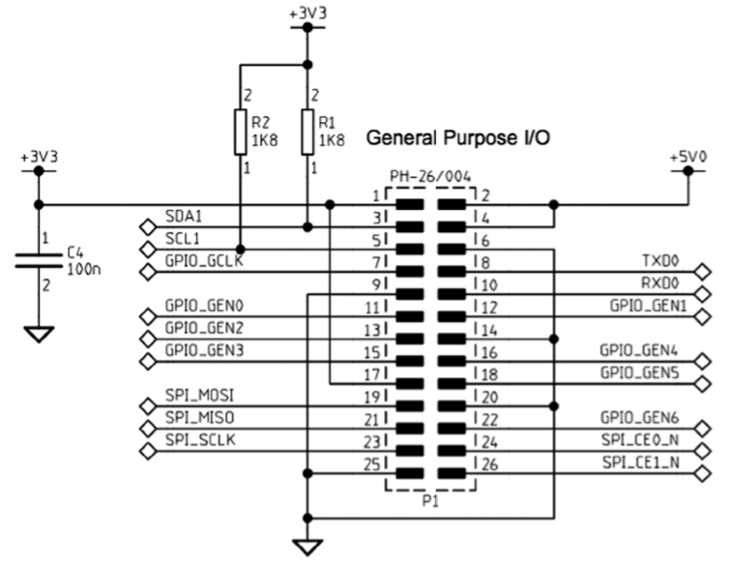
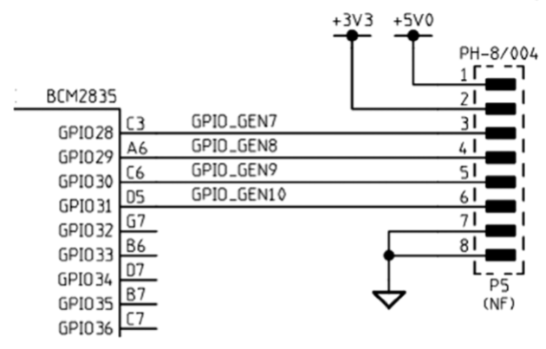
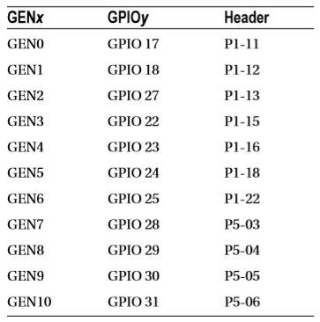
Matering The Raspberry GPIO

Slide 27
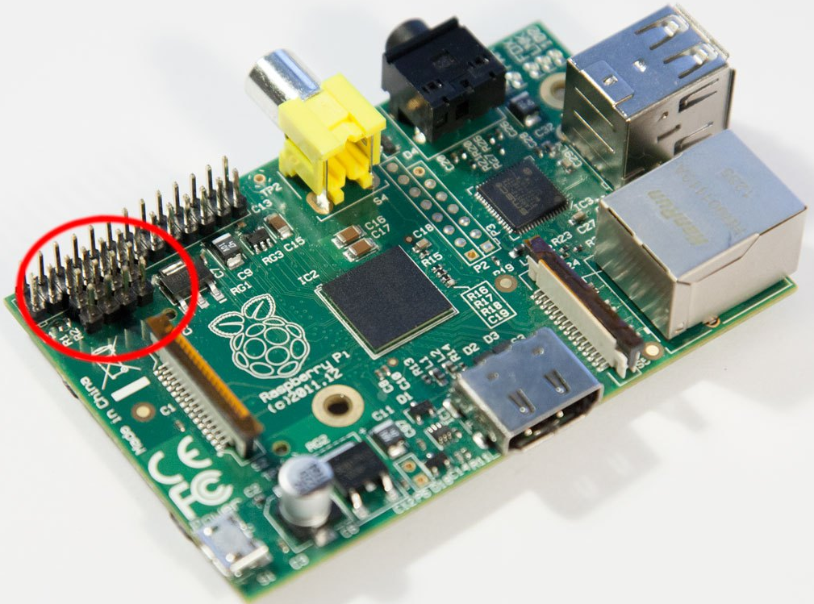
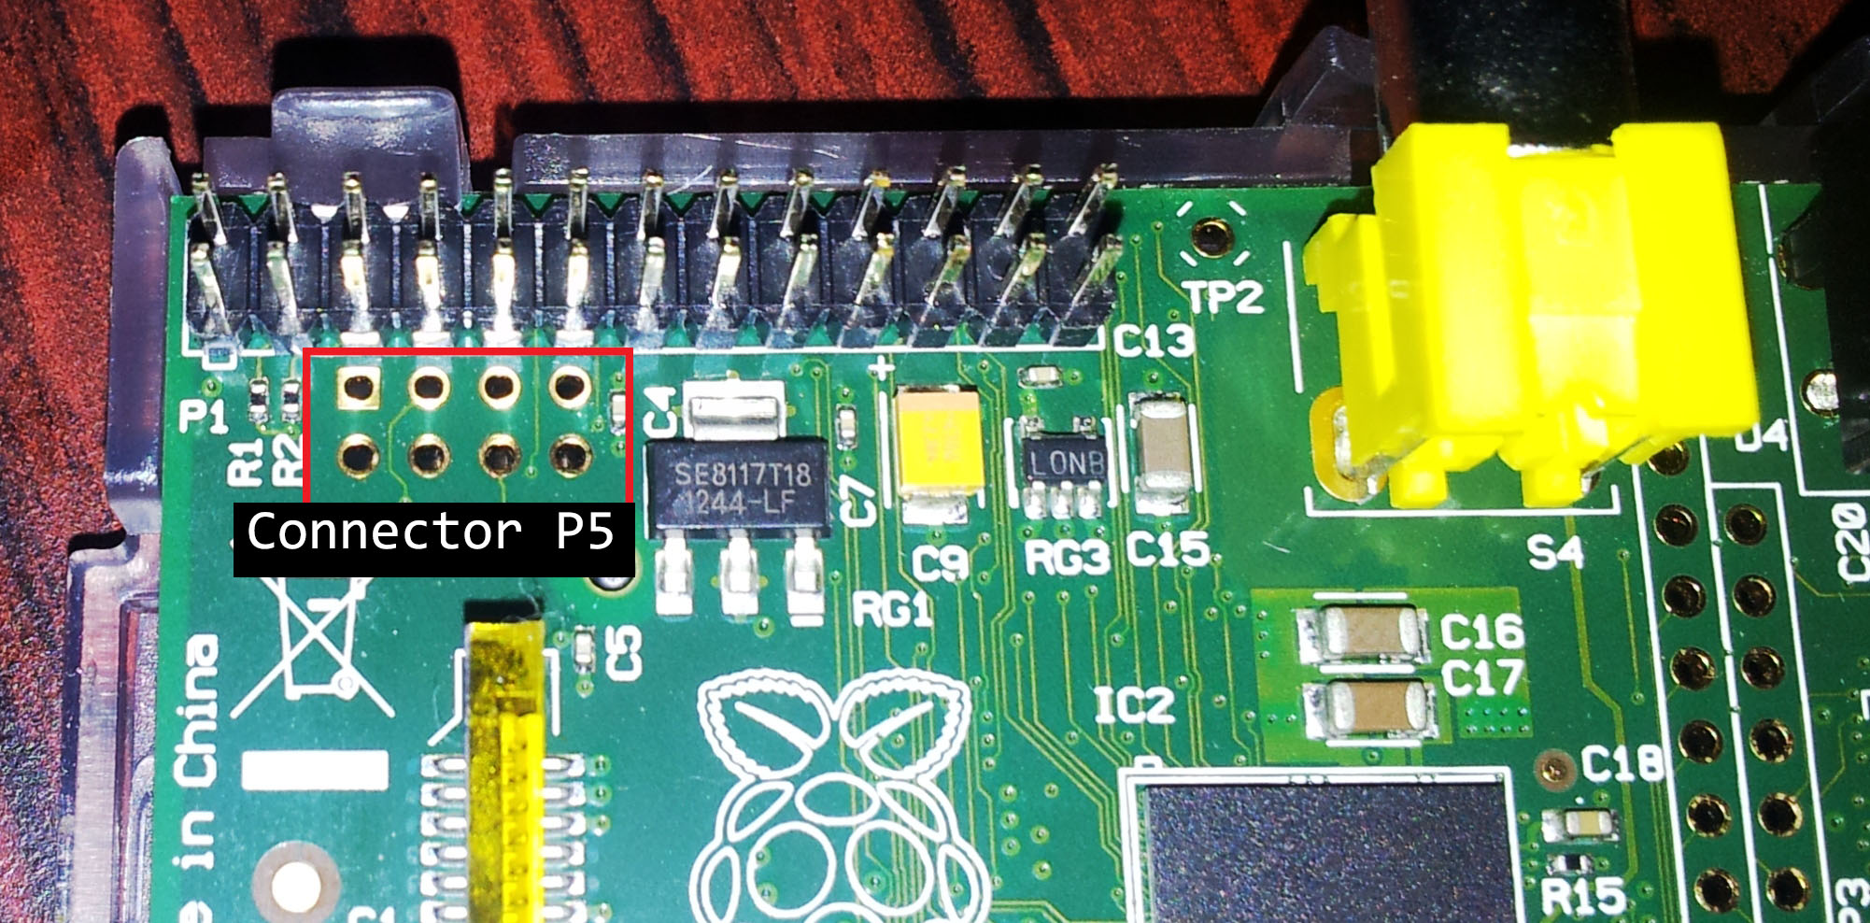
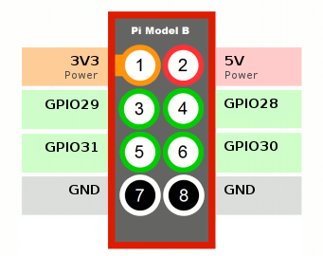
Matering The Raspberry GPIO

Slide 28
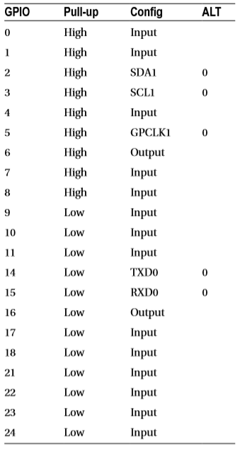
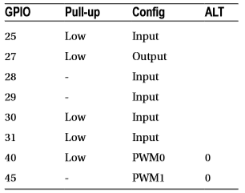
Configuration After Reset
Upon reset, most GPIO pins are configured as general-purpose inputs
with the exceptions noted in Following Table. The Pull-up column
indicates how the internal pull-up resistor is initially configured.
The pull-up resistors apply when the GPIO is configured as an input pin

Slide 29
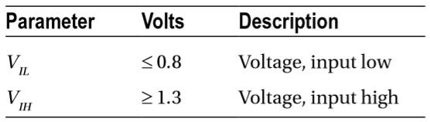
Logic Levels
GPIO pins use 3 V logic levels. The precise BCM2835 SoC logic-level specifications are as follows:
The voltage levels between VIL and VIH are considered to be ambiguous or undefined, and must be avoided.

Slide 30
Driving Logic Interfaces
For the receiving logic, the output level must be at least VIH to reliably register a 1 bit (for the BCM2835, this is 1.3 V). Likewise, the output should present less than VIL to reliably register a 0 in the receiver (for the BCM2835, this is 0.8V). Any voltage level between these limits is ambiguous and can cause the receiver to randomly see a 0 or a 1.
There are a fairly large number of approaches to interfacing between different logic families. A good source of information is provided by the document “Microchip 3V Tips ’n Tricks.”
Another document titled “Interfacing 3V and 5V Applications, AN240” describes the issues and challenges of interfacing between systems. It describes, for example, how a 5 V system can end up raising the 3 V supply voltage if precautions are not taken.
Approaches to interfacing include direct connections (when safe), voltage-dividing resistors, diode resistor networks, and the more-complex op-amp comparators. When choosing an approach, remember to consider the necessary switching speed of the interface required.

Slide 31
Drive Strength
The design of the SoC is such that each GPIO pin can safely sink or source up to 16 mA without causing it harm
The drive strength is also software configurable from 2 mA up to 16 mA
The boot-up default is to use the drive strength of 8 mA
the GPIO outputs 28 to 45 were found configured for 16 mA (GPIO 28 to 31 are available on header P5).

Slide 32
Drive Strength
It should be mentioned that these drive capabilities are not current limiters in any way. What they do is apply more amplifier drive in order to meet the logic-level requirements
If the GPIO output is wired up to a light load like a CMOS chip or MOSFET transistor where little current is drawn, then the minimum drive of 2 mA suffices. The single GPIO 2 mA buffer can effortlessly establish a logic high in its proper voltage range as well as bring the voltage to a logic low when required.

Slide 33
Input Pins
A GPIO input pin should experience voltages only between 0 and the 3.3 V maximum. Always exercise caution when interfacing to other circuits that use higher voltages like TTL logic, where 5 V is used. The SoC is not tolerant of overvoltages and can be damaged.
While there exist protection diodes for protecting against negative input swings, these are weak and intended only to bleed away negative static charges. Be sure to design your input circuits so that the GPIO input never sees a negative input potential.

Slide 34
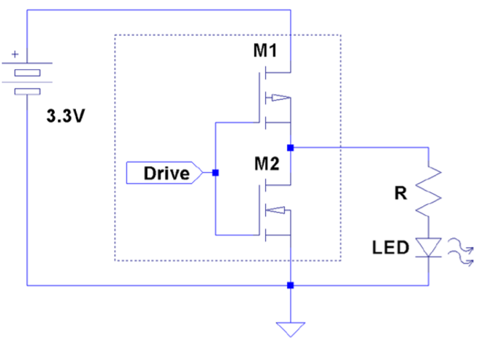
Driving LEDs
Following figure shows the active high configuration’s Rload circuit element substituted with an LED and limiting resistor R. Since there is no current limiting provided by the GPIO port, resistor R must be provided to do this.

Slide 35
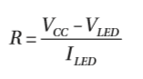
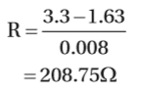
Driving LEDs
When an LED is hooked up to the GPIO output port, Rload becomes the LED and the limiting resistor (in series). The math is complicated slightly by the fact that the LED is a diode. As a diode, it has a voltage drop, which should be subtracted from the supply voltage. For red LEDs, the voltage drop is usually between 1.63 and 2.03 V. Knowing the current draw you want for the LED, the resistor R can be calculated from the following:
where VCC is the supply voltage (+3.3 V). VLED is the voltage drop for the LED. ILED is the required current draw for the LED. For VLED it is best to assume the worst case and assume the lower voltage drop of 1.63 V. Assuming we need 8 mA to get reasonable brightness from the LED, we can calculate the resistance of the limiting resistor:
Since resistors come in standard values, we round up to a standard 10% component of 220 Ω

Slide 36
Configuration
Each GPIO pin is affected by several configuration choices:
General-purpose input, output, or alternate function
Input event detection method
Input pull-up/pull-down resistors
Output drive level

Slide 37
How to Acess GPIO
Software Driver
Direct Regiter Access

Slide 38
Sysfs GPIO Access
In this section, we’re going to access the GPIO pins through the /sys pseudo file system. This is the GPIO driver interface.
Because it provides file system objects, it is possible to control GPIO pins from the command line (or shell).
The driver is able to receive interrupts when a GPIO state changes. This information can in turn be passed onto the application program using poll() or select().

Slide 39
Sysfs GPIO Access
Everything that you need for GPIO access is rooted in the top-level directory:
/sys/class/gpio
At this directory level, two main control pseudo files are maintained by the driver. These are write-only:
export: Requests the kernel to export control of the requested GPIO pin by writing its number to the file unexport: Relinquishes control of the GPIO pin by writing its number to the file
Normally, the kernel manages the GPIO pins, especially if they are used for resources that need them (like the UART). In order for an application to manipulate a GPIO pin, it must first request that the kernel relinquish control of the requested pin. From a userspace perspective, the operation is like opening a file. The script or program should be prepared for failure in the event that a GPIO pin is busy.

Slide 40
Sysfs GPIO Access
It is tempting to perform some operations from a nonroot account, using sudo like this:
$ sudo echo 17 >/sys/class/gpio/export
-bash: /sys/class/gpio/export: Permission denied
this does not work because the I/O redirection is performed by the shell before the sudo command begins. Change to interactive mode first and then the operation will succeed:
$ sudo -i
# echo 17 >/sys/class/gpio/export

Slide 41
export
After a successful run, list the directory /sys/class/gpio:
# ls
export gpio17 gpiochip0 unexport
A new subdirectory (a symlink to a directory, actually) named gpio17 appears. This tells you that the kernel has given up control of GPIO 17 and has provided you this file system object to manipulate. At this point, you can consider the GPIO 17 as available.

Slide 42
unexport
Some applications may require a GPIO pin for only a short time. When the application is finished with the pin, the application can release the pin back to the kernel. This is done by writing to the unexport pseudo file:
$ sudo -i
# echo 17 >/sys/class/gpio/unexport
After this command completes, the pseudo object gpio17 disappears from the /sys/class/gpio directory. This confirms that the GPIO is now being managed by the driver and makes it impossible for userspace programs to mess with it (except for direct register access).

Slide 43
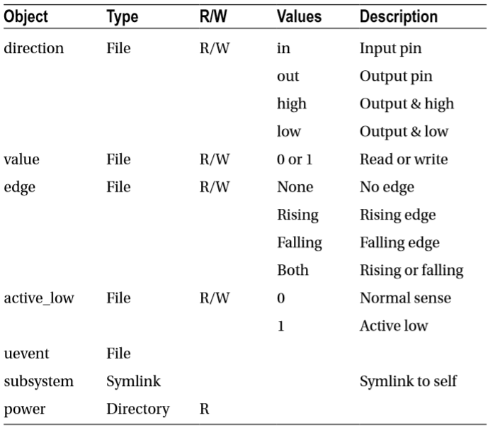
gpioX
Once you have a file system object like /sys/class/gpio/gpio17 to work with, you can configure it and perform I/O. The main objects that you’ll see are outlined in following Table. The ones normally used by shell programs are simply as follows:
direction: To set the I/O direction
value: To read or write the I/O bit
active_low: To alter the sense of logic

Slide 44
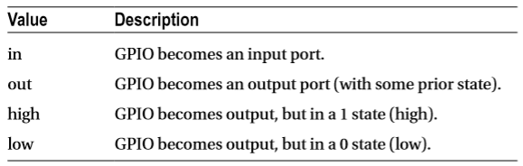
gpioX
The values used for direction are worth expanding on:
The high and low options look like convenience frills, but they’re not. Consider configuring an output and setting it to 1:
# echo out >/sys/class/gpio/gpio17/direction
# echo 1 >/sys/class/gpio/gpio17/value

Slide 45
gpioX
Some time will pass before the execution of the second command takes place to establish the correct output level. If the GPIO output state was previously left in a zero state, the GPIO 7 pin will reflect a 0 (low) until the second command completes. For electronic devices operating in nanosecond time frames, this can be a problem. To provide glitch-free configuration, the following can be done instead:
# echo high >/sys/class/gpio/gpio7/direction
This way, the driver takes the necessary steps to establish the correct output level prior to making the pin an output.

Slide 46
GPIO Tester
If you decided to build yourself a prototype board with the Raspberry Pi mounted on it, you may find this simple shell script useful for checking the wiring of the GPIO breakout clips. Or perhaps you just want to verify that the connection brought out to the breadboard is the correct one. Simply supply the GPIO pin number that you want to blink, on the command line:
GPIO="$1"
SYS=/sys/class/gpio
DEV=/sys/class/gpio/gpio$GPIO
if [ ! −d $DEV ] ; then
# Make pin visible
echo $GPIO >$SYS/export
fi
# Set pin to output
echo out >$DEV/direction

Slide 47
GPIO Tester
function put() {
# Set value of pin (1 or 0)
echo $1 >$DEV/value
}
while true ; do
put 1
echo "GPIO $GPIO: on"
sleep 1
put 0
echo "GPIO $GPIO: off $(date)"
sleep 1
done
# End
When testing with an LED and alligator clip lead, ground yourself to the ground pin first (or better still, a good ground like a water tap). Static electricity can be especially bad in the winter months. It not only can cause your Pi to reset but also can inflict internal damage. After discharging yourself to the ground pin, apply the lead and allow time enough for 1-second-on and 1-second-off events.

Slide 48
GPIO Input Test
To test out the GPIO input capability, a simple script is presented next
By default, it assumes 0 for the active low setting, meaning that normal logic applies to the input values. If, on the other hand, a 1 is used, inverted logic will be applied. Using the script named input, apply one of the following commands to start it (^C to end it):
# ./input 0
The script, of course, can be modified, but as listed, it reads an input on GPIO 4 and presents what it has read to GPIO 18 .
It additionally reports what has been read to standard output. If the output (GPIO 18) is wired to an LED, the input status will be visible in the LED .
The script has its limitations, one of which is that the sleep(1) command is used. This causes it to have a somewhat sluggish response. If you don’t like that, you can comment out the else and sleep commands. As a consequence, it will hog the CPU, however, but be more responsive

Slide 49
GPIO Input Test
#!/bin/bash
INP=4 # Read from GPIO 4
OUT=18 # Write t o GPIO 18
set −eu
trap "close_all" 0
function close_all() {
close $INP
close $OUT
}
function open() { # pin direction
dev=$SYS/gpio$1
if [ ! −d $dev ] ; then
echo $1 >$SYS/export
fi

Slide 50
GPIO Input Test
echo $2 >$dev/direction
}
function close() { # pin
echo $1 >$SYS/unexport
}
function put() { # pin value
echo !$2 >$SYS/gpio$1/value
}
function get() { # pin
read BIT <$SYS/gpio$1/value
echo $BIT
}

Slide 51
GPIO Input Test
count=0
SYS=/sys/class/gpio
open $INP in
open $OUT out
put $OUT 1
LBIT=2
while true ; do
RBIT=$(get $INP)
if [ $RBIT −ne $LBIT ] ; then
put $OUT $RBIT
printf "%04d Status : %d\n" $count $RBIT
LBIT=$RBIT
let count=count+1
else
sleep 1
fi
done
# End

Slide 52
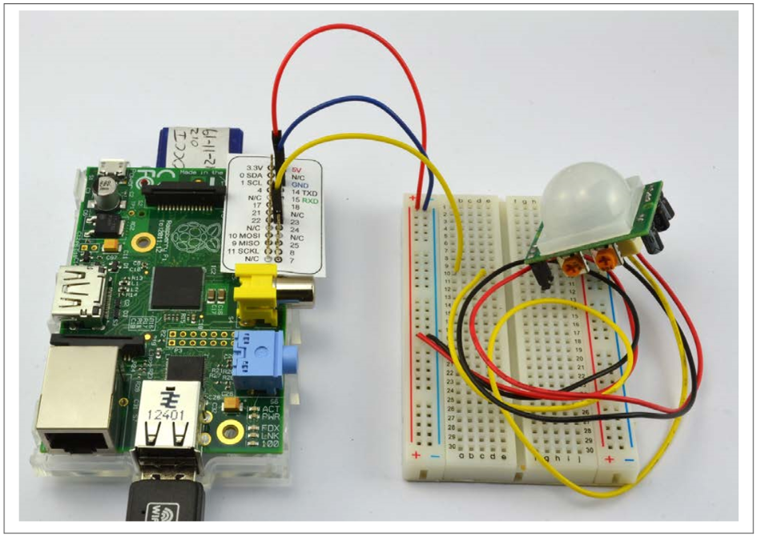
Using a Breadboard with Jumper Leads

Slide 53
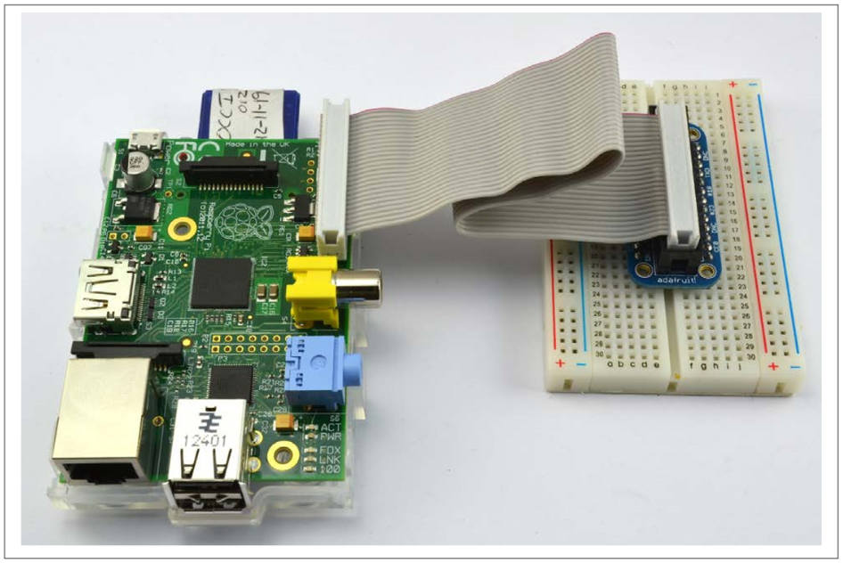
Using a Breadboard with a Pi Cobbler

Slide 54
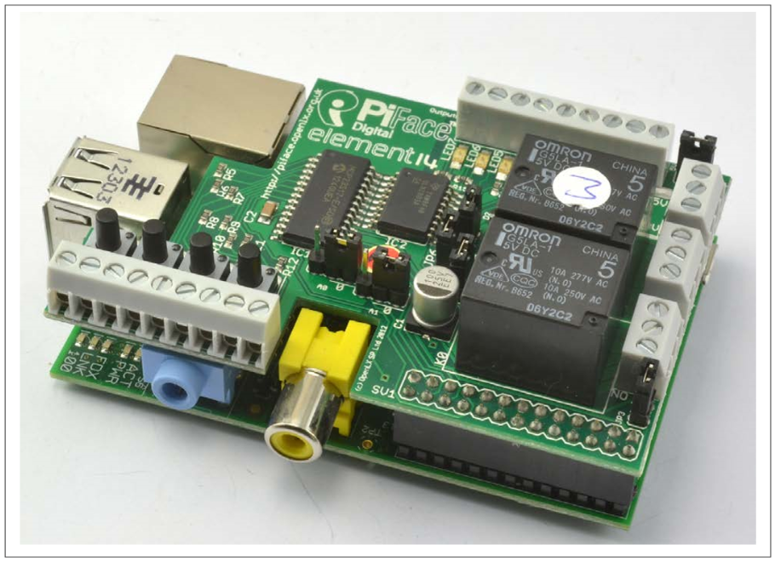
Getting Started with a PiFace Digital Interface Board

Slide 55
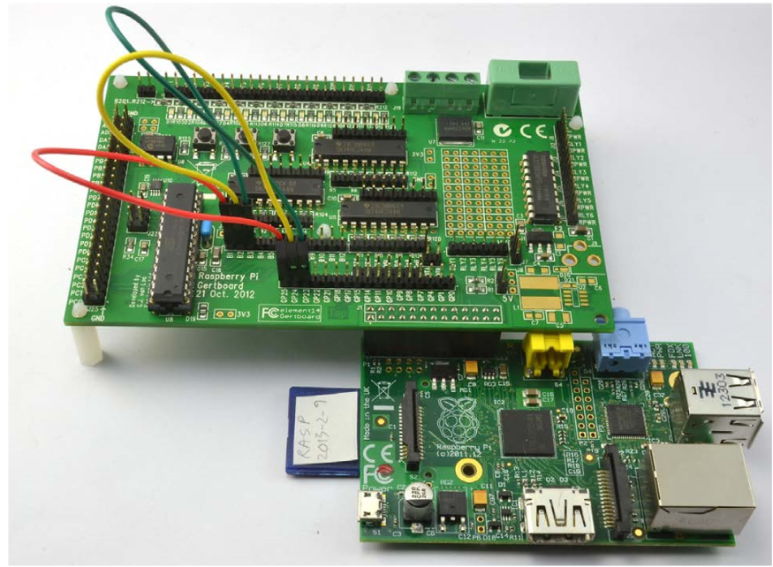
Getting Started with a Gertboard

Slide 56
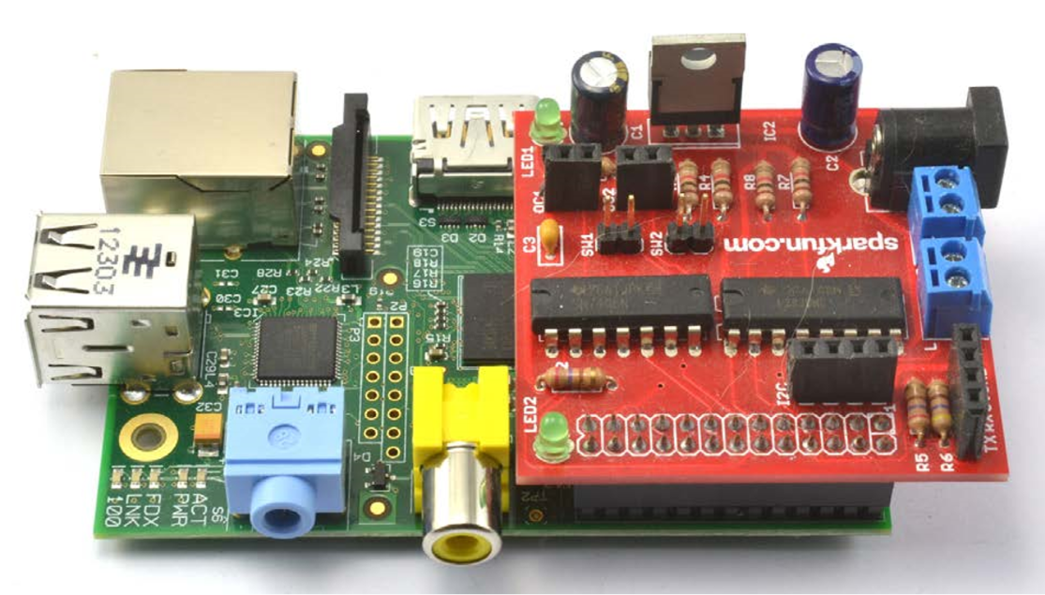
Getting Started with a RaspiRobot Board

Slide 57
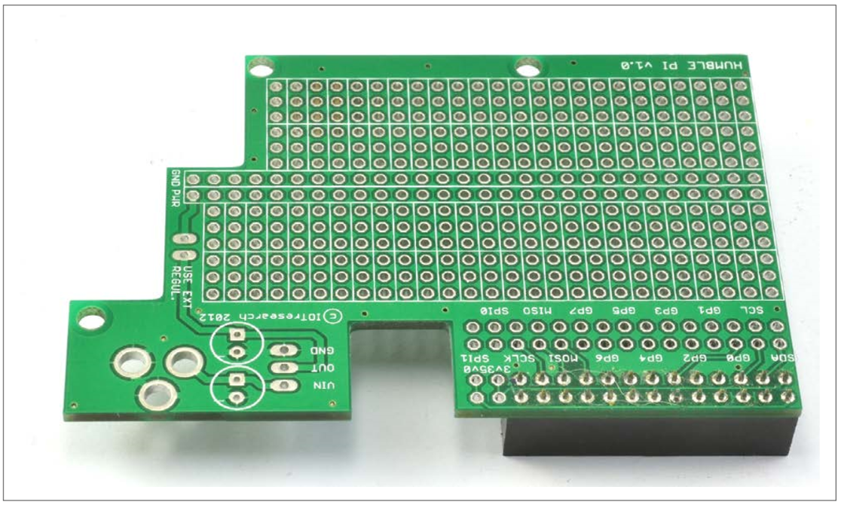
Using a Humble Pi Prototyping Board

Slide 58
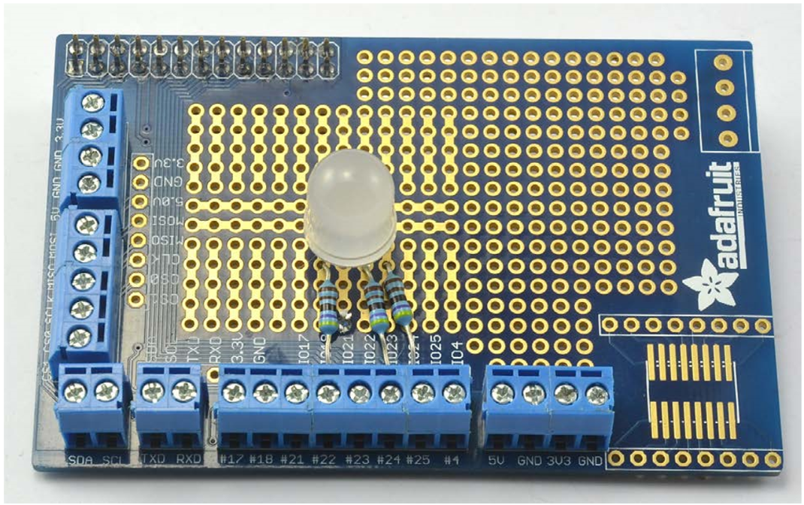
Using a Pi Plate Prototyping Board

Slide 59
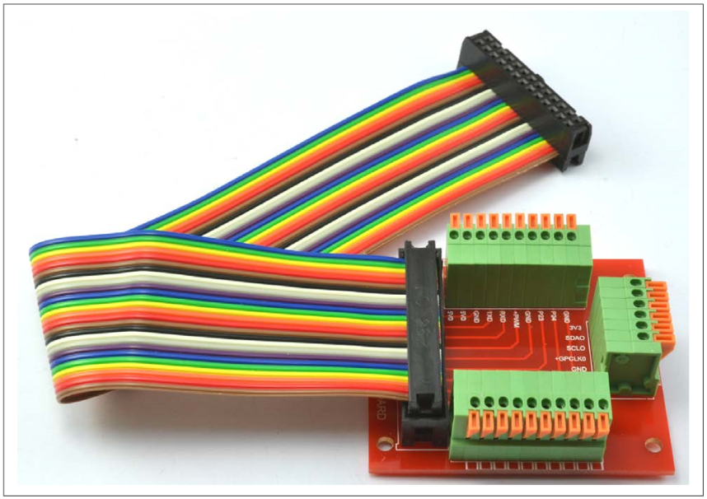
Using a Paddle Terminal Breakout Board

Slide 60
Using a Paddle Terminal Breakout Board

Slide 61


Contact us
www.e-system.ir
Info@e-system.ir

